Slide 1
Compliant Plug-In
maxime.tournier@inria.fr
INRIA-DEMAR
and M. Nesme, B. Gilles, F. Faure
this document is licensed under CC 4.0 BY-SA

Slide 2
Overview
Introduction
Theory
Implementation Notes
Examples

Slide 3
Introduction
Harmonize ForceFields/Constraints handling
  (Re)use mappings as much as possible
Holonomic constraint = infinite stiffness
  = zero compliance
Simplify constraint solvers, genericity

Slide 4
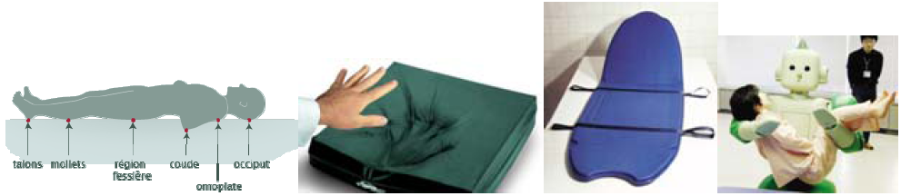
Context
SoHuSim ANR
  (Soft Human Simulation)
  Human/environment mechanic interactions
Constrained mechanical systems
  Rigid/deformable objects
  Constraints: bilateral/unilateral/friction/…
Bi-phasic materials
  Tendons, ligaments

Slide 5

Constraints in SOFA
Projective
  FixedConstraint
LMConstraints
constraintset
… ?
Compliant
(xkcd)

Slide 6
Philosophy
Constraint = ForceField
  Very (very) stiff !
Mappings do most of the work
  No PlaneConstraint, LineConstraint, ...
  Instead: PlaneNormalMapping, LineNormalMapping, … + stiff ForceField at the end
Factorize code whenever possible
  in the ‘Flexible’ plug-in spirit

Slide 7
Very (very) stiff ?
Stiffness matrix K → +∞
  Numerically instable
Compliance : C = inv(K) → 0
Formulate dynamics using compliance

Slide 8
Theory

Slide 9



Time integration
Implicit linear velocity update:
Typically:

Slide 10




Constraints: KKT systems
Holonomic constraint:
Gradients :
Correction :

Slide 11

Elasticity: mapped stiffness
Mapping: g(q)
Apply stiffness matrix K_{g} on mapped dofs g(q)
Stiffness on q is:

Slide 12


Elasticity: compliant KKT system
Compliance:
  [Servin06]
Constraints: same system with C = 0

Slide 13
Schur Complement
Assuming H is easily invertible:
“Regularized” constraint system
  Smaller than KKT system !
  Positive (semi-)definite

Slide 14
In a nutshell
Constraint = stiff ForceField
Handle ForceFields as compliance
  Easy transition towards very (very) stiff, C → 0
Numerical solves on KKT or Schur system

Slide 15
Implementation Notes

Slide 16

Compliance API
BaseForceField additions:
  bool isCompliance()
  BaseMatrix* getComplianceMatrix(...)
For now, complete KKT system assembly
  Mapping J matrices must be provided
  Will probably change eventually
Not a lot to implement, don’t worry

Slide 17
Solvers
AssembledSystem
OdeSolver
KKTSolver
Integration scheme
Constraint stabilization
...
Velocity / position correction
Lagrange multipliers
...

Slide 18
Numerical solvers
Direct
  LDLT, … (courtesy of Eigen library)
Krylov
  CG, MINRES
Matrix-splitting
  (block) Gauss-Seidel

Slide 19
(More) numerical solvers
Projected Gauss-Seidel
  Unilateral/friction constraints
In CompliantDev (ask us):
  [Silcowitz-Hansen10]
    Speedup PGS + Fletcher-Reeves
  [Otaduy09]
    Friction + deformable, PGS variant
  [Kaufman08]
    Staggered Projections

Slide 20
Compliant contacts
Two contact responses:
  Unilateral: CompliantContact
  Coulomb friction: FrictionCompliantContact
  (Only CompliantContact will remain)
Simply tell the ContactManager to use them
  To get compliant contacts

Slide 21
Stabilization
Add these next to a compliant ForceField:
  odesolver::Stabilization
Ask AssembledSolver for a stabilization pass:
  stabilization=”true”

Slide 22
Use Schur complement
Add a Response component next to the KKTSolver
  Abstraction of inv(H)
  e.g. DiagonalResponse
  Naming sucks (we know)
Solvers will use optimized inverse

Slide 23
Python Library
Simplifies scene graph creation *a lot*
  For mere mortals
Rigid bodies + most classic kinematic joints
Typical examples:
  Spherical joint + angular stiffness + damping
  Angular limits

Slide 24
Examples

Slide 25
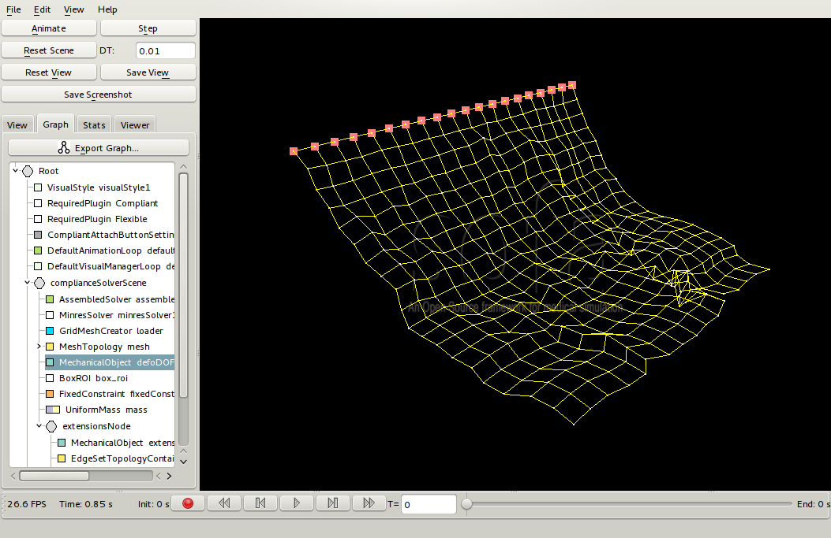
Cloths
Start from a regular 2D mesh
Mesh vertices are point masses
Map relative distances along the mesh edges
Apply UniformCompliance on relative distances
Notes:
TODO image

Slide 26
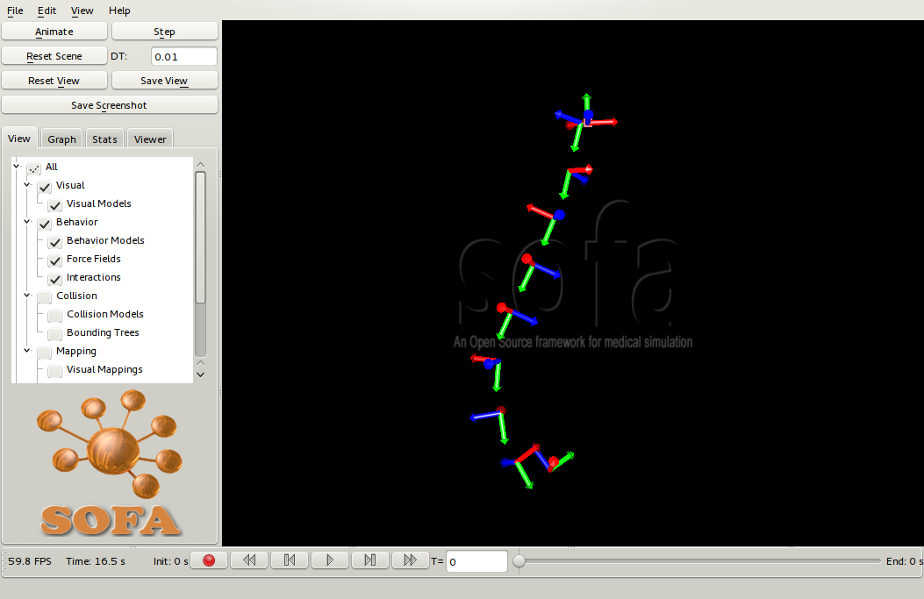
Articulated Chain
Map parent/child rigid frames for the joint
RigidJoint(Multi)Mapping
  = joint dofs
UniformCompliance on translation part
  [+Stabilization] to avoid drift
Notes:
TODO image

Slide 27
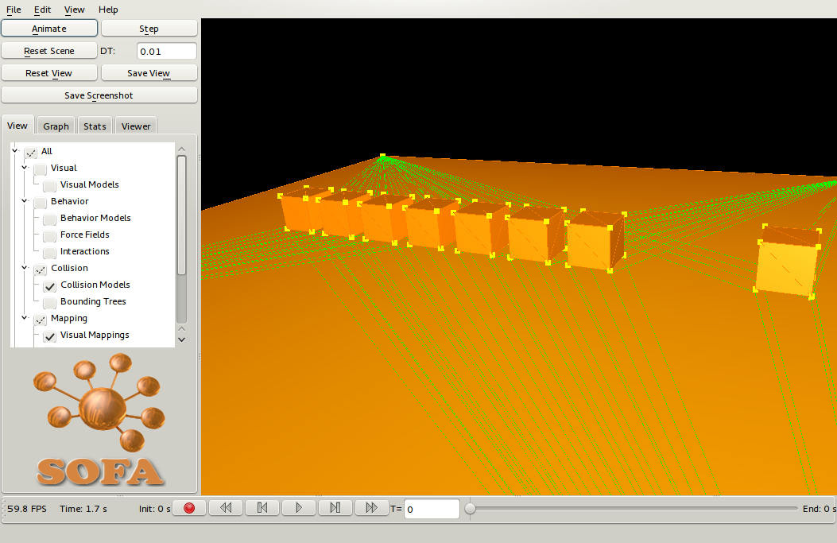
Contacts
Map contact point pairs, relative distances
Apply UniformCompliance
  [+ Stabilization]
  [+ Restitution]
Unilateral constraint:
  + UnilateralConstraint
Notes:
TODO image/vidéo ?

Slide 28
Discussion
Unified elasticity/constraint handling
(re)use mappings whenever possible
Minor modifications to existing code

Slide 29
Discussion
Lots of components !
  Options would only make it worse
  No “default” configuration
  Python helps *a lot*
Assembly = slow, but:
  Simplified solver implementation
  Generic
  “easy” parallelization

Slide 30
Final remarks
Plays along nicely with the Flexible plug-in
Currently under refactoring !
  Cleaning !
  Documentation ! yay !
  Wait a couple of weeks before using :-)
Python >> XML
  Wrap gory details into a nice user API

Slide 31
Thank you !
maxime.tournier@inria.fr

